Slide 1




www.cases.org.uk

Slide 2
CASES Student Representative Roles
Purpose
Represent and promote the interests of sport and exercise science students within the Division
Key Responsibilities
Advise CASES staff and Board on student-related issues.
Support development of student-focused membership benefits.
Drive student engagement in Division activities.
Represent the Division on the CASES Student Advisory Group (approx. three meetings/year).

Slide 3
Why Get Involved?
Shape the student experience of sport and exercise science
Build your professional network
Boost your career prospects
Enhance your skillset
Be a voice for students

Slide 4
How Can I Get Involved?
Ensure you are a CASES Student or Graduate member
Access information on the CASES website: https://www.cases.org.uk/

Slide 5
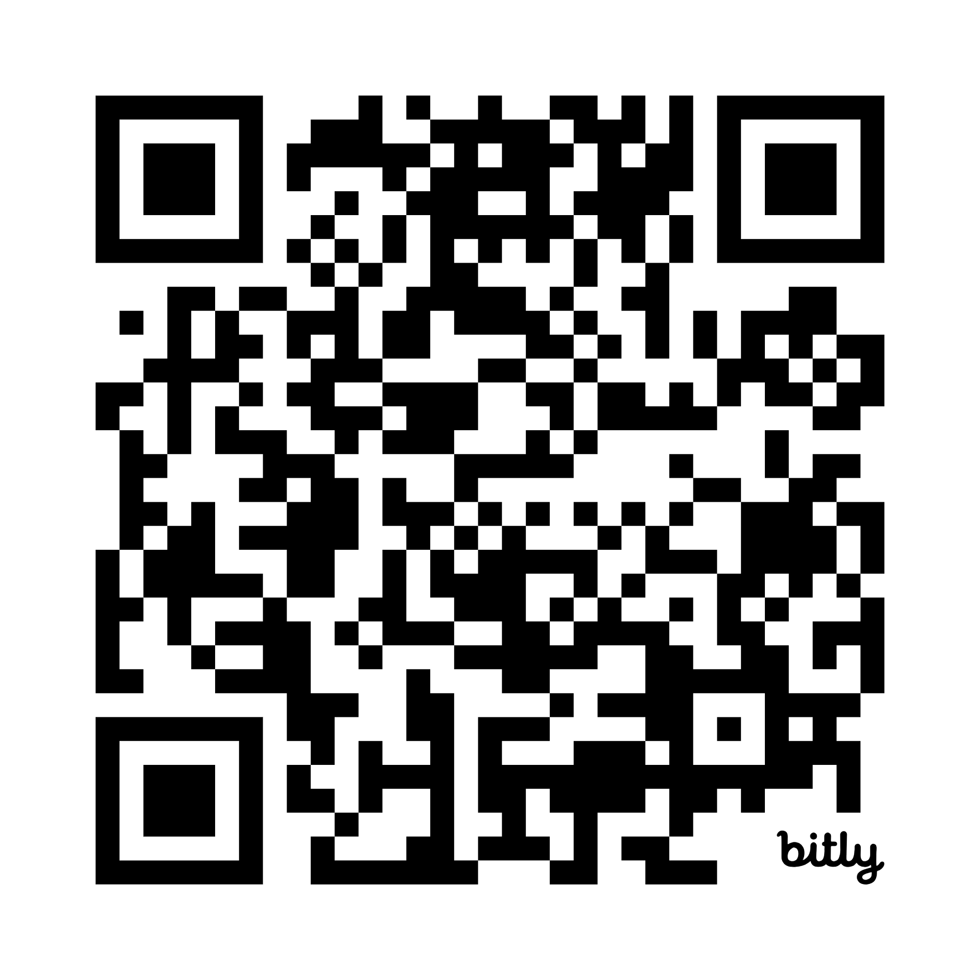
Current Student Representative
Positions (Sept 25)
Psychology Division Committee:
Postgraduate Student Rep*
Undergraduate Student Rep*
Sport and Performance Division Committee:
Undergraduate Student Rep*
* Division Student Reps (Postgrad and Undergrad) also serve on the CASES Student Advisory Group (SAG).

